Slide 1
.NET Memory
by Dmytro Hnidyi

Slide 2
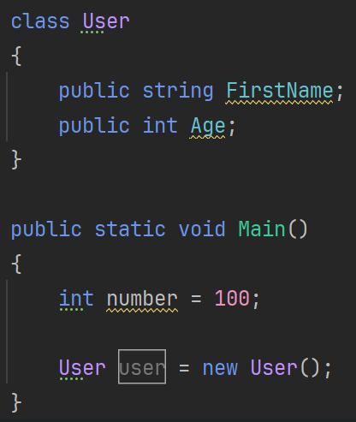
Value Type & Reference Type
Main()
Stack
number: 100
user:
User
Heap
FirstName: null
Age: 0

Slide 3
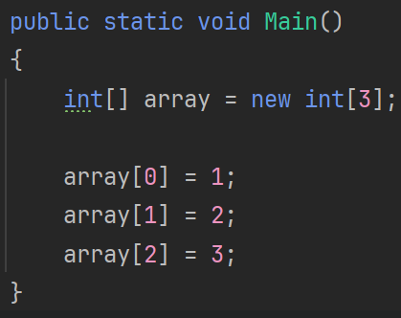
Array reference type
Main()
Stack
array:
Array
Heap
1
2
2
3

Slide 4
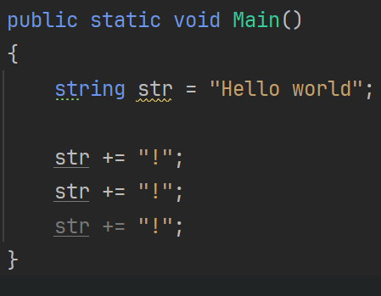
String reference type
Main()
Stack
str:
String
Hello world!!!
Heap
String
Hello world!
String
String
Hello world
Hello world!!

Slide 5
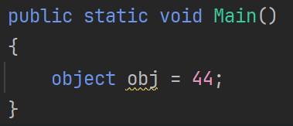
Value Type Boxing
Main()
Stack
obj:
Object
Heap
44

Slide 6
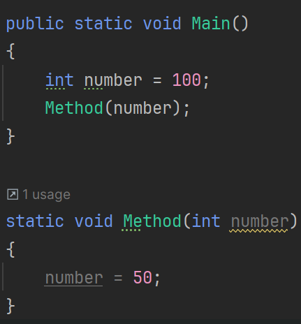
Value Type Copying
Main()
Method()
Stack
number: 100
number: 50
Heap

Slide 7
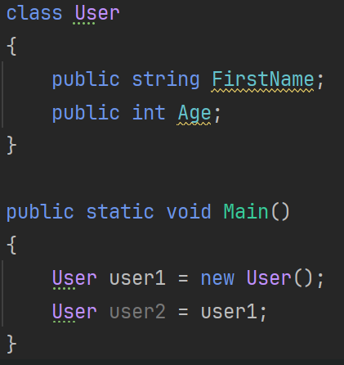
Reference Type Copying
Main()
Stack
user1:
user2:
User
Heap
FirstName: null
Age: 0

Slide 8
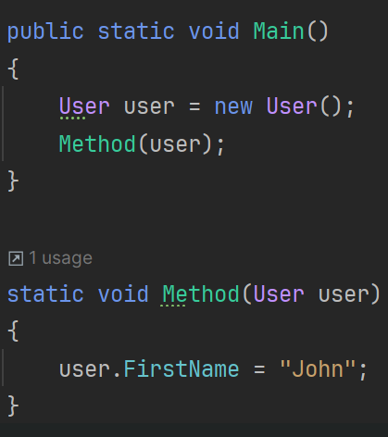
Reference Type Copying
Main()
Method()
Stack
user:
user:
User
String
Heap
FirstName:
Age: 0
John

